Slide 1

NIMBUS CORE Application Architecture and Technologies
By
GOTTAM SATEESH

Slide 2
Nimbus Platform provides an integrated set of tools designed to overcome the below challenges
Ability to leverage this new outsourcing capability
Allow the on-demand resources to share security and configuration context
Manage the deployment of potentially diverse platform
Ensure reliability and scalability in the environment

Slide 3
Nimbus Core Architecture
Nimbus Client (Angular)
Controller
Service
Repo
Model
Embed Mongo DB

Slide 4
Technologies used
Spring
Spring security
Embed Mongo
AngularJS (6.1.0), etc..

Slide 5
Spring Framework
A popular and stable Java application framework for enterprise development
Ubiquitous for Java development
Well established in enterprise Java apps
Time tested and proven reliable
A primary purpose is to reduce dependencies and even introduce negative dependencies
Different from almost every other framework out there
Part of the reason it has been adopted so quickly

Slide 6
Spring Architecture
Spring AOP
Source-level metadata
AOP Infrastructure
Spring ORM
Hibernate Support
iBatis Support
JDO Support
Spring Web
Web Application Context
Multipart Resolver
Web Utilities
Spring Web MVC
Web MVC Framework
JSP / Velocity
PDF / Excel
Spring DAO
Transaction infrastructure
JDBC support
DAO Support
Spring Context
Application Context
UI Support
Validation
JNDI, EJB Support & Remoting mail
Spring Core
Supporting utilites
Bean Container

Slide 7
What does Spring offer?
Dependency Injection
Also known as IoC (Inversion of Control)
Aspect Oriented Programming
Runtime injection-based
Portable Service Abstractions
The rest of spring
ORM, DAO, Web MVC, Web, etc.
Allows access to these without knowing how they actually work

Slide 8
Spring Features
Lightweight: Spring Framework is lightweight with respect to size and transparency.
Inversion Of Control (IOC): In Spring Framework, loose coupling is achieved using Inversion of Control. The objects give their own dependencies instead of creating or looking for dependent objects.
Aspect Oriented Programming (AOP): By separating application business logic from system services, Spring Framework supports Aspect Oriented Programming and enables cohesive development.
Container: Spring Framework creates and manages the life cycle and configuration of application objects.
MVC Framework: Spring Framework is a MVC web application framework. This framework is configurable via interfaces and accommodates multiple view technologies.
Transaction Management: For transaction management, Spring framework provides a generic abstraction layer. It is not tied to J2EE environments and it can be used in container-less environments.
JDBC Exception Handling: The JDBC abstraction layer of the Spring Framework offers an exception hierarchy, which simplifies the error handling strategy.

Slide 9
Spring Security
“Spring Security is a powerful, flexible security solution for enterprise software, with particular emphasis on applications that use Spring”
Spring Security:
Provides declarative security for Spring based applications.
Handles Authentication and Authorization
Takes full advantage of the dependency injection (DI) and aspect-oriented techniques based on the spring framework.

Slide 10
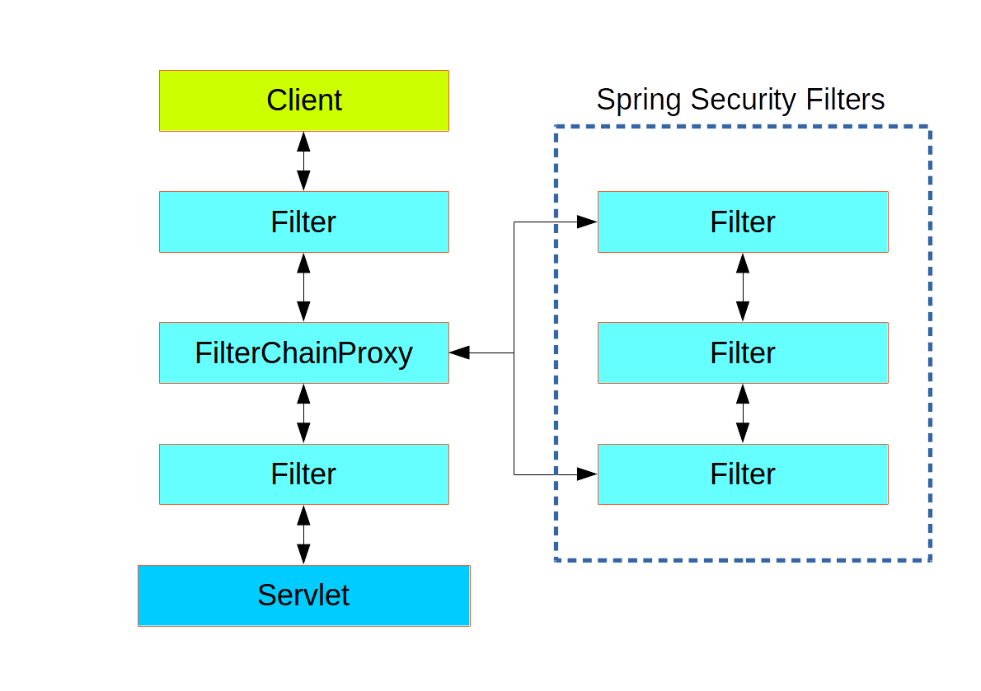
Spring Security Architecture

Slide 11
Spring security features
Authentication and Authorization.
Supports BASIC, Digest and Form-Based Authentication.
Supports LDAP and OpenID Authentication.
Supports SSO (Single Sign-On) Implementation.
Supports Cross-Site Request Forgery (CSRF) Implementation.
Supports “Remember-Me” Feature through HTTP Cookies.
Supports Implementation of ACLs
Supports “Channel Security” that means automatically switching between HTTP and HTTPS.
Supports I18N (Internationalisation), JAAS (Java Authentication and Authorization Service).
Supports Flow Authorization using Spring WebFlow Framework, WS-Security using Spring Web Services.
Supports Both XML Configuration and Annotations. Very Less or minimal XML Configuration.
Supports WebSocket Security and Spring Data Integration.
CSRF Token Argument Resolver.

Slide 12
Mongo DB
MongoDB is a cross-platform, document oriented database that provides, high performance, high availability, and easy scalability. MongoDB works on concept of collection and document.
The best MongoDB experience. Access data directly from your frontend code, intelligently distribute data for global apps, trigger serverless functions in response to data changes, and much more.
MongoDB is a free and open-source cross-platform document-oriented database program. Classified as a NoSQL database program, MongoDB uses JSON-like documents with schemata. MongoDB is developed by MongoDB Inc., and is published under a combination of the Server Side Public License and the Apache License.

Slide 13
Why MongoDB?
Simple queries
Functionality provided applicable to most web applications
Not well suited for heavy and complex transactions systems
Easy and fast integration of data
No ERD diagram

Slide 14
Functionality of MongoDB
Dynamic schema
No DDL
Document - based database
Secondary indexes
Query language via an API
Atomic writes and fully - consistent reads
If system configured that way
Master - slave replication with automated failover (replica sets)
Built - in horizontal scaling via automated range - based partitioning of data.
No joins nor transactions

Slide 15
Mongo DB Features
Schema less
Structure of a single object is clear
No complex joins
Deep query-ability. MongoDB supports dynamic queries on documents using a document-based query language that's nearly as powerful as SQL
Easy tuning
Ease of scale-out
Conversion / mapping of application objects to database objects not needed
Uses internal memory for storing the (windowed) working set, enabling faster access of data

Slide 16
Angular JS(6.0.1)
Angular is a platform that makes it easy to build applications with the web. Angular combines declarative templates, dependency injection, end-to-end tooling, and integrated best practices to solve development challenges. Angular empowers developers to build applications that live on the web, mobile, or the desktop.
There are many front-end JavaScript frameworks to choose from today, each with its own set of trade-offs. Many people were happy with the functionality that Angular 1.x afforded them. Angular 2+ improved on that functionality and made it faster, more scalable and more modern. Organizations that found value in Angular 1.x will find more value in Angular 2+

Slide 17
Why Angular?
Easier
Angular is a more streamlined framework that allows programmers to focus on simply building JavaScript classes. Views and controllers are replaced with components, which can be described as a refined version of directives.
TypeScript
Angular 2 was written in TypeScript, a superset of JavaScript that implements many new ES2016+ features.
Familiarity
Despite being a complete rewrite, Angular 2+ has retained many of its core concepts and conventions with Angular 1.x, e.g. a streamlined, "native JS" implementation of dependency injection.

Slide 18
Performance and Features
Performance and Mobile
Angular was designed for mobile from the ground up. Angular, like React and other modern frameworks, can leverage performance gains by rendering HTML on the server or even in a web worker.
New features
Form builder
Change Detection
Templating
Routing
Annotations
Observables

Slide 19
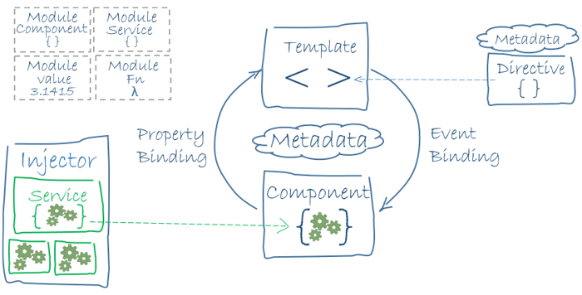
Angular JS Architecture

Slide 20
For any queries please feel free to contact me on the below mentioned email / mobile.
THANK YOU.
Gottam Sateesh
+91-9347387973
sateeshreddy132@gmail.com

